Slide 1
Hyperlynx SI modeling overview Dmitry Vasilchenko
Where today meets tomorrow.
Restricted © Siemens 2022

Slide 2
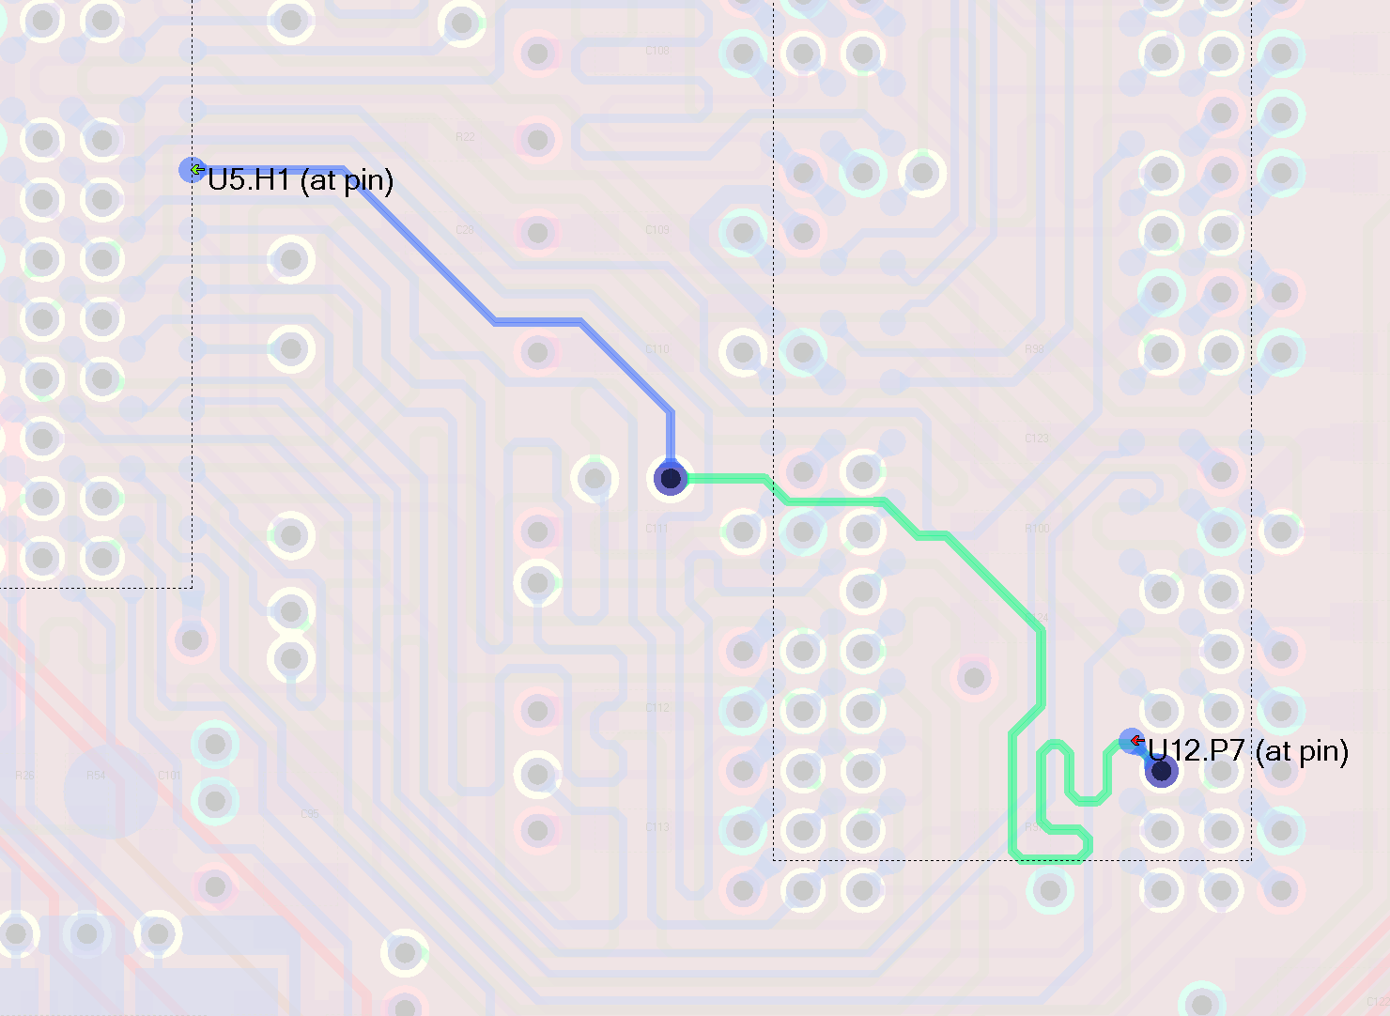
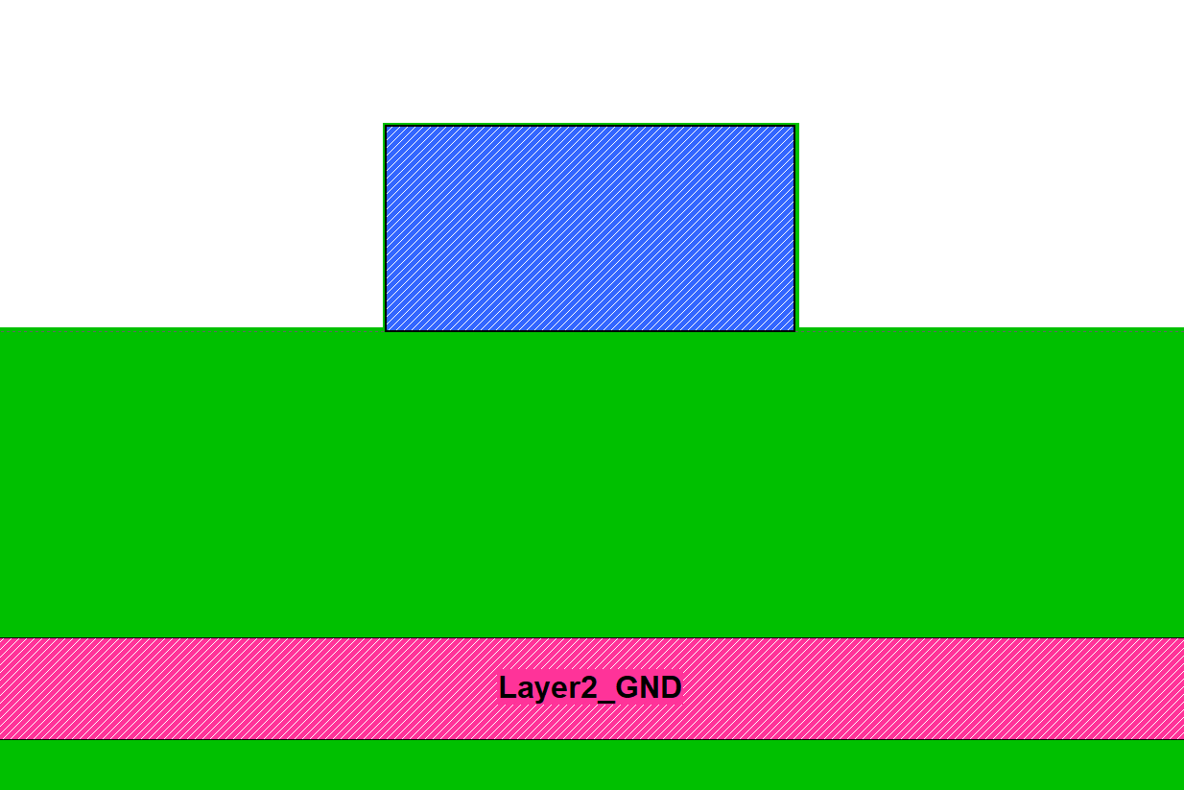
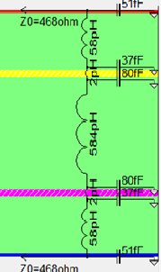
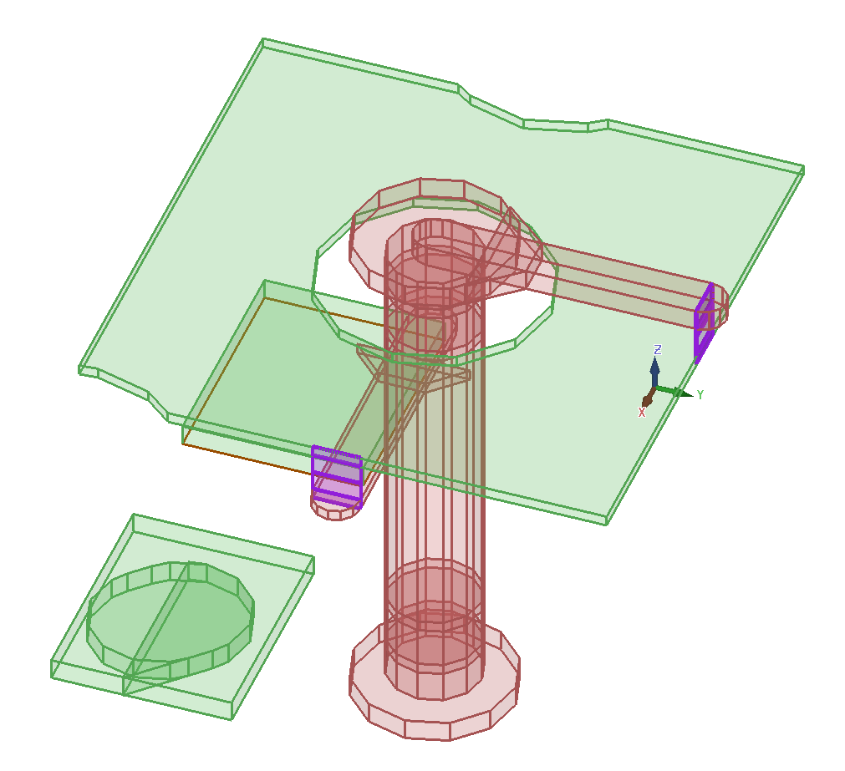
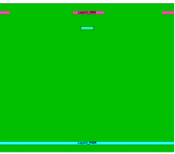
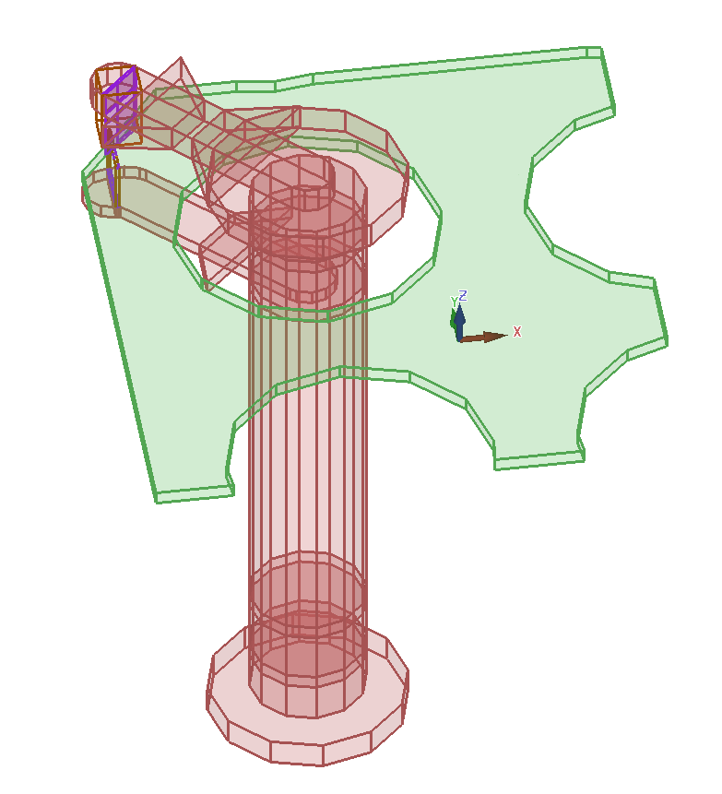
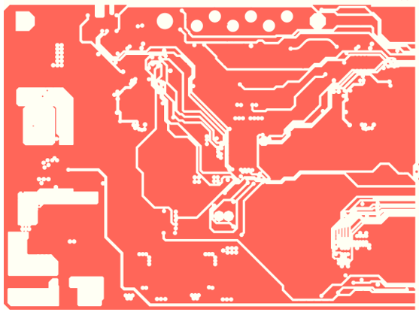
BoardSim SI modeling
Trace Modeler builds crossections, accounts for area fills, finds coupled nets
Via Modeler runs for vias/pins
IBIS models for devices

Slide 3
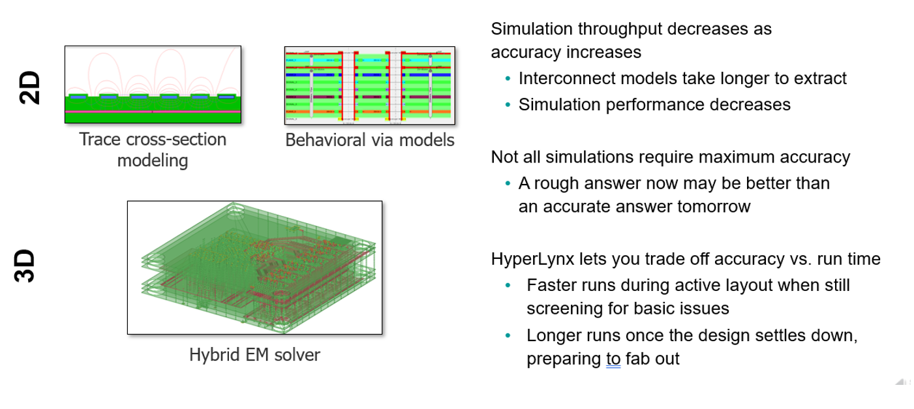
SI modeling: 2D vs 3D models

Slide 4
SI modeling components, BoardSim
Trace Modeler
Builds nGrpah with connected transmission lines and via/pin ports; finds aggressors
Field Solver
Solves crossections for RLCG matrixes
Via Modeler
Lumped via model as LC chain (default)
Advanced via model as spice model
BoardSim does not directly support 3D via model, only via in 3D areas
3D Area manager
Replaces insides of 3D area with a spice model from solved in HLAS
Model Builder
Loads IBIS, EBD and EMD models, finds switching coefficients k(t) for IBIS drivers
Netlister
Makes binary netlist basing on nGraph, Via Model, Model builder, hybrid s-parameter model.
SimAPI
Runs simulator of choice (HyperSim, ADMS, HSPICE) for a given binary netlist
EZWave
WDB Server stores and handles waveforms for all time domain simulations

Slide 5
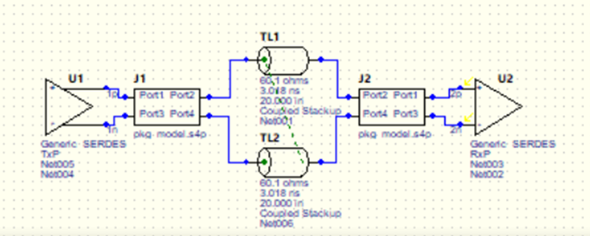
LineSim SI simulation
Field Solver
Solves t-lines for RLCG matrixes (coupled, AF)
Via Modeler
Lumped LC model (default)
Advanced via model
3D via model - native support
Model Builder
Loads IBIS, EBD and EMD models, finds switching coefficients k(t) for IBIS drivers
FFS Netlister
Makes binary netlist basing on schematic symbols, Via Model, Model builder.
SimAPI
Runs simulator of choice (HyperSim, ADSM, HSPISE) for a given binary netlist
EZWave
WDB Server stores and handles waveforms for all time domain simulations

Slide 6
Crosstalk and SSN effects
Hyperlynx supports automatic aggressor selection using
Trace coupling thresholds: geometrical or electrical
IBIS package coupling in dB
Multiboard connector coupling in dB
S-parameter coupling in dB: 3d areas in BS, blackbox in LS
Power bus coupling for power-aware IBIS models
Manual nets selection by net list, net name mask(s) or RMB picks
Simulation for all coupling effects above and PDN coupling for power-aware simulations
Use Manage Assigned model to check and update IBIS model selectors, active drivers, stimulus.

Slide 7
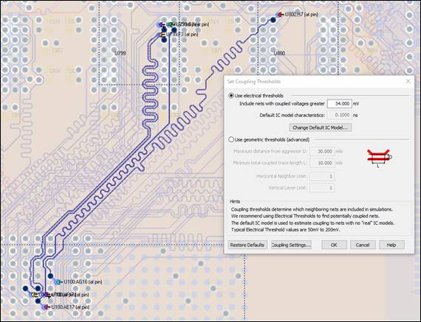
SI Coupling Settings

Slide 8
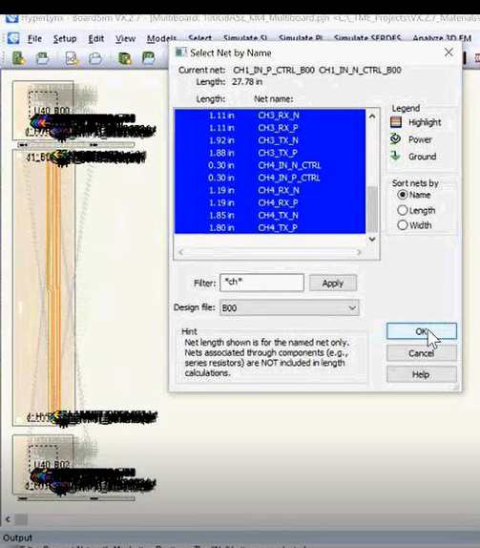
Multiple nets selection in BoardSim

Slide 9
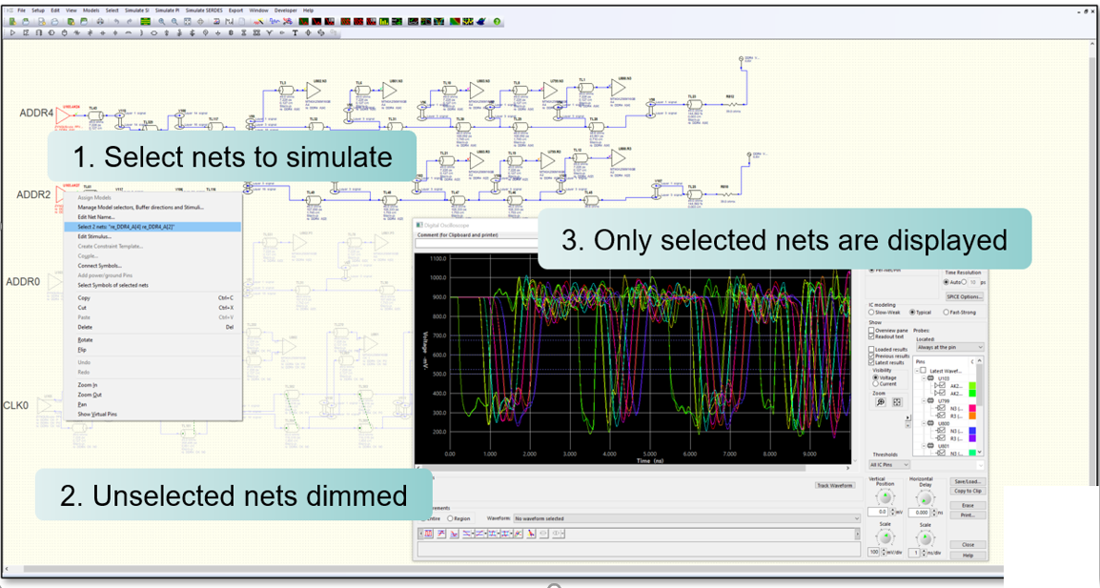
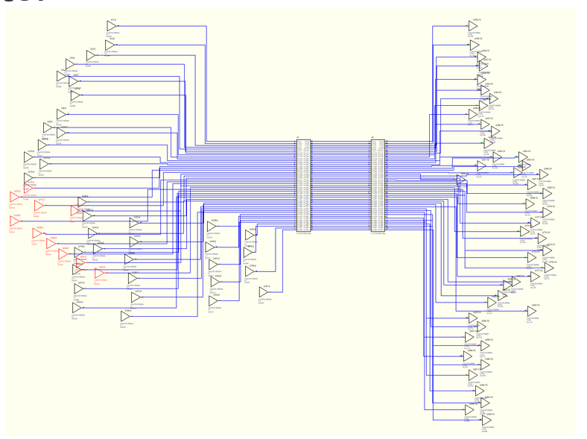
Nets selection in LineSim
Most important for DDR batch performance
Look and feel as in BoardSim.
Manual, by net name(s) or RMB for selected symbols.
Automatic for batch analysis – net by net.
Includes aggressors basing on coupling s-parameter coupling thresholds (in dB)
Unselected black box ports get terminated as defined in touchstone model

Slide 10
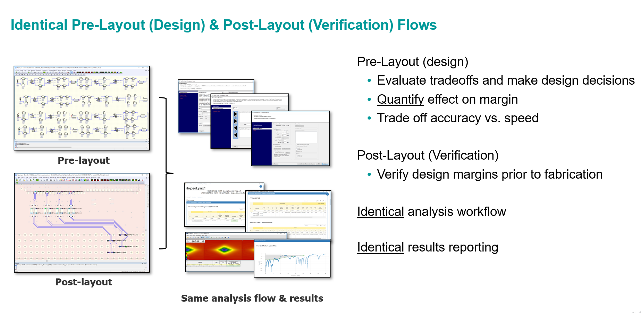
Summary

Slide 11
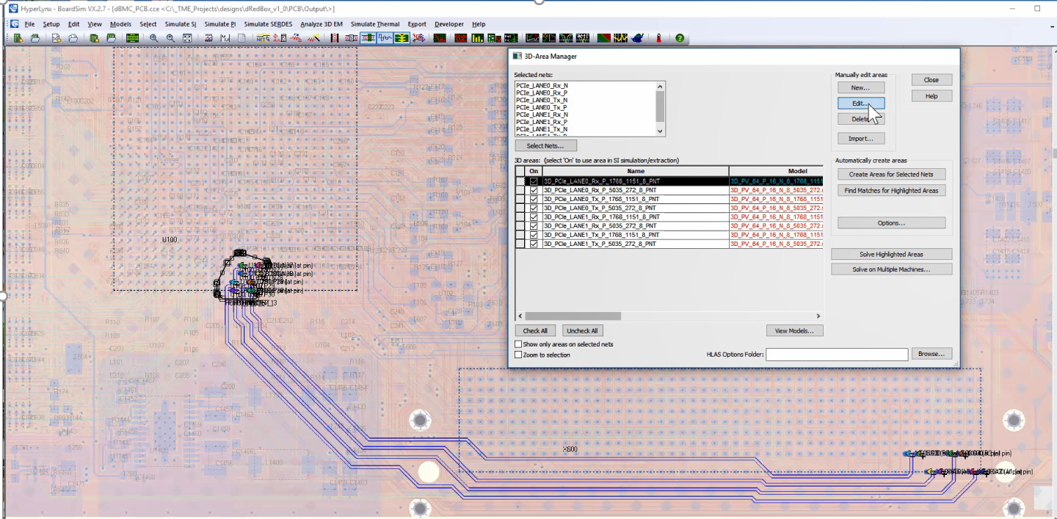
3D models - 3D Area Manager
3D area manager automatically creates areas around via and pins using HLDRC script

Slide 12
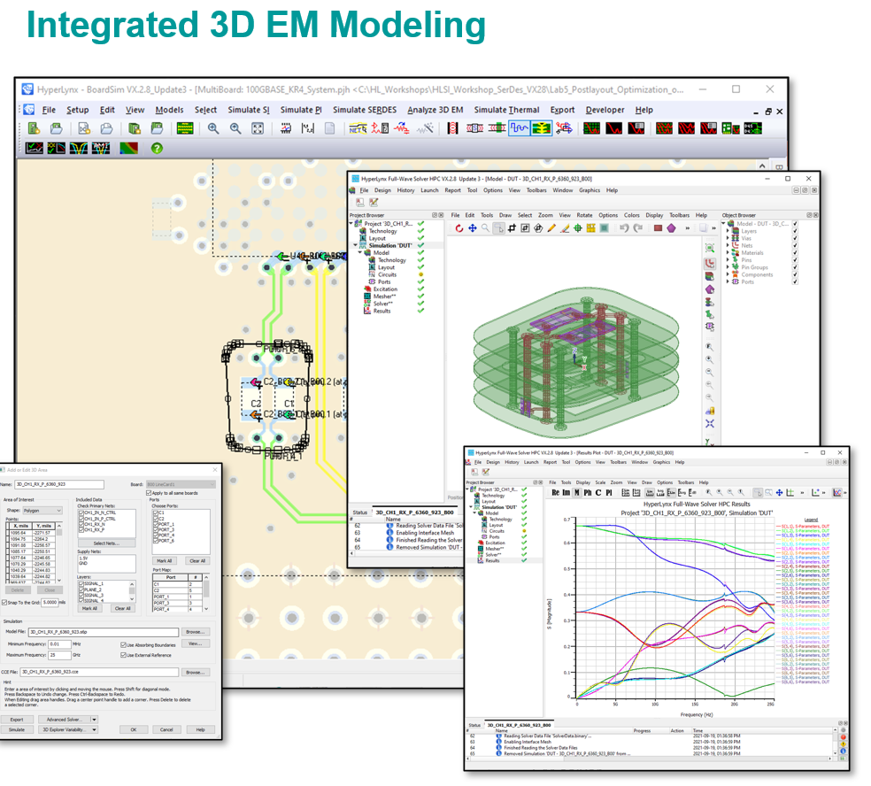
3D areas are solved in HLAS and exported to LS

Slide 13
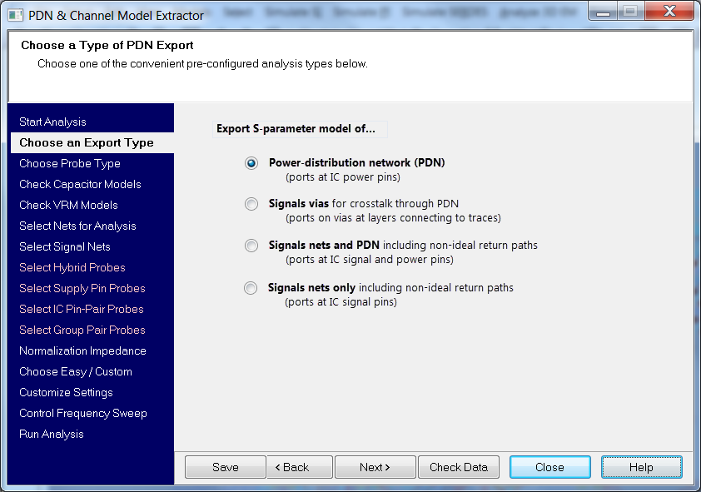
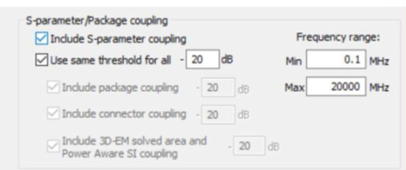
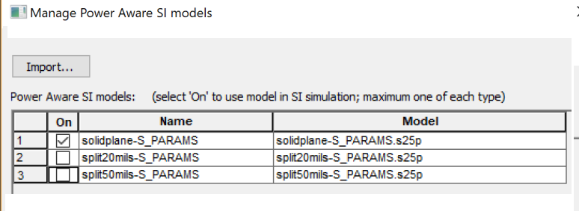
3D models - Hybrid modeling
Use PDN & Channel Export Wizard to choose signal and power nets and solve it in HLAS.
Import solved s-parameter model(s) into BoardSim. It gets associated with signal nets using port information from s-parameter header.
Now all SI simulations use this 3D model instead of 2D whenever net is involved in simulation. VX.2.12 supports mixes 2d and 3d models in one simulation (of cause without EM coupling between 2d and 3d sections)
Aggressors selected basing s-parameter coupling

Slide 14
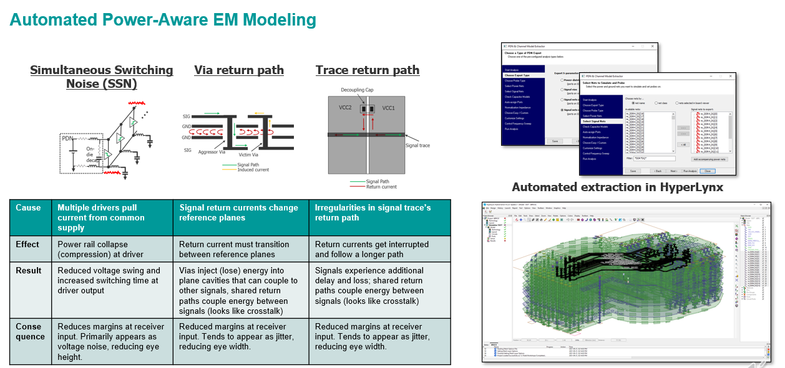
Summary

Slide 15
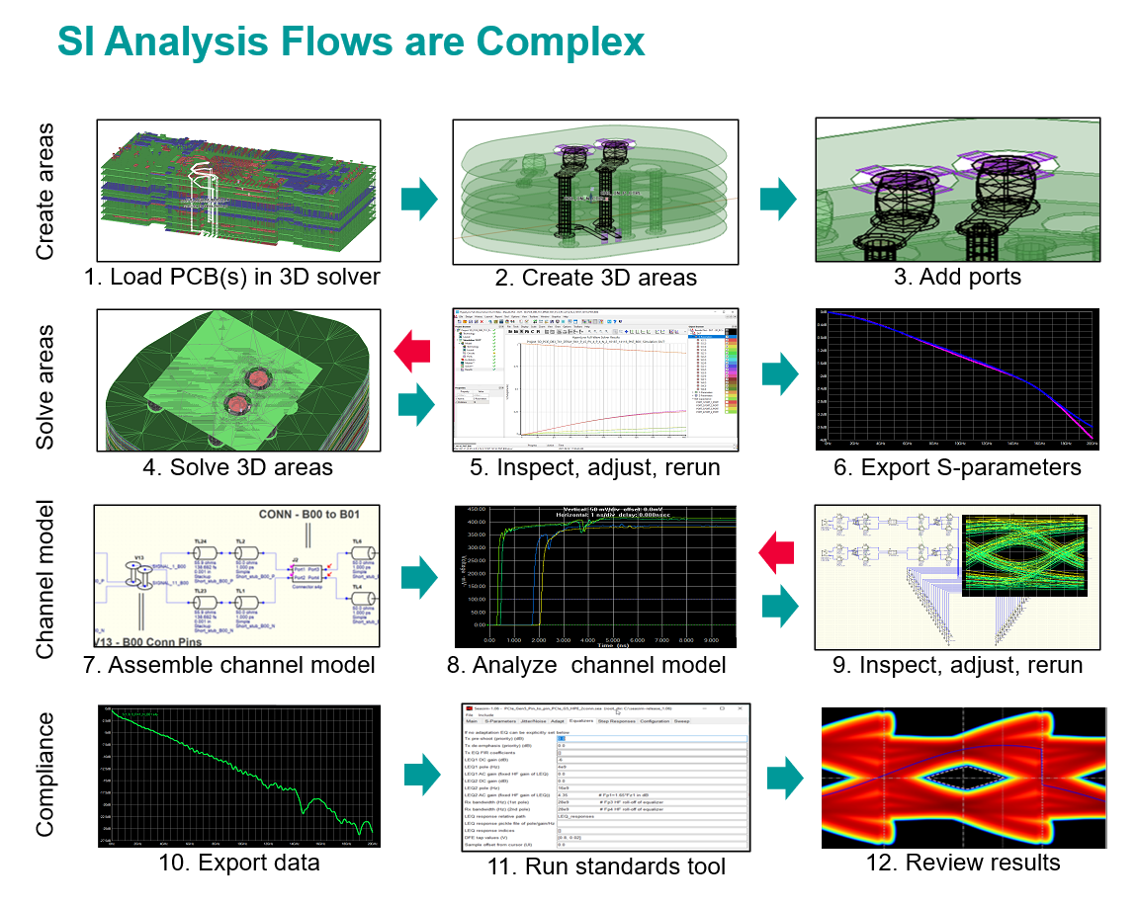
Summary

Slide 17
Interactive SI simulations
Two flows: Oscilloscope and EZwave
Traditionally, HL customers prefer Oscilloscope.
EZwave is more complex but powerful. It supports many views with annotations, includes waveform calculator, handles huge waveforms.
Though all these features are overkill if all you do is comparing RX waveforms for two consecutive simulations.
EZWave with measurements
Performs Timing/SI/Crosstalk measurements for selected signal. Works in BoardSim and LineSim.
Essentially, it’s ancestor of General Batch
Interactive DDR5 simulation
Run complex DDR5 data lane simulation interactively to prepare, assess and debug batch ddr5 simulations

Slide 18
SI batch analysis
General Batch Wizard
For low data rate signals
Pulse Respond Wizard
Quick assess channel’s quality from RX pulse response basing o ISI/crosstalk metrics. Simple setup, no models.
DDRx Wizard
Setup and analyze DDRx memory interface
Inside it runs multibit SI simulations for clock, address, strobe and data lines
SerDes Wizard
Check differential channel(s) for compliance with serial link protocols: PCIE, USB,
Includes functions of deprecated FastEye Wizard

Slide 19
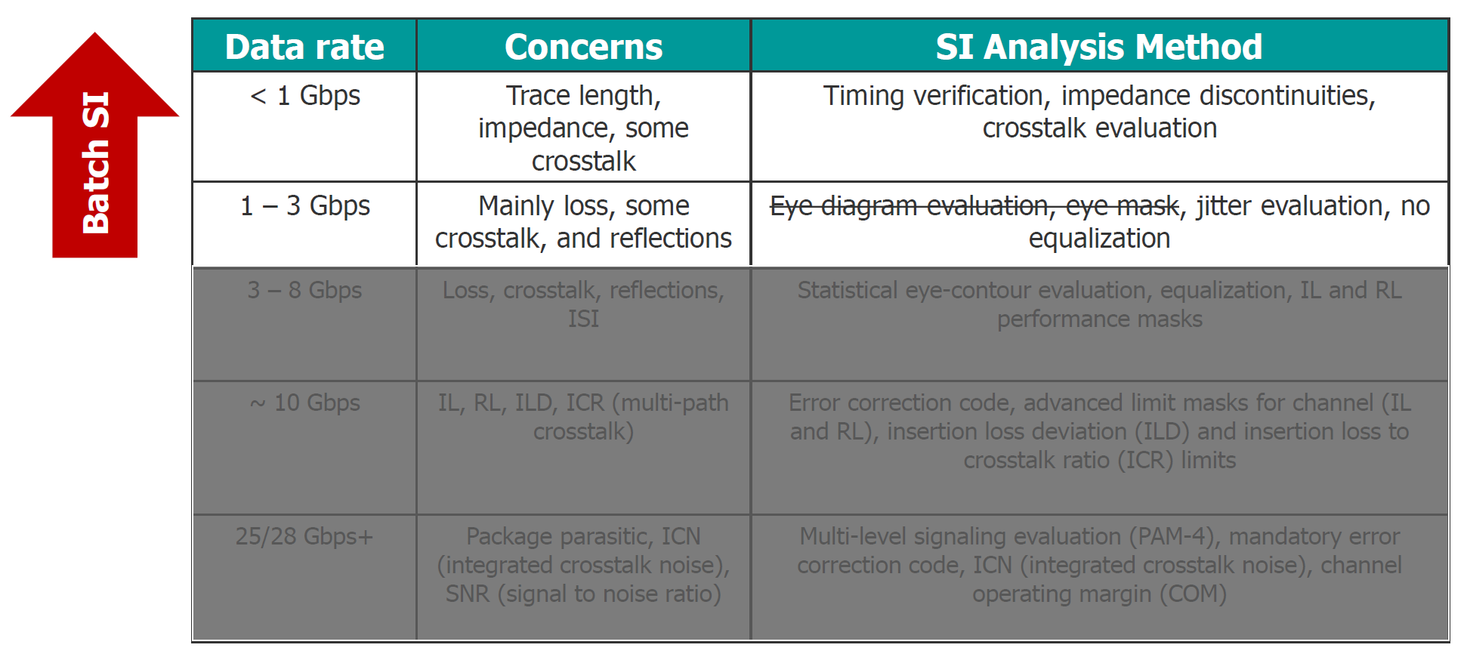
SI concerns for different data rate

Slide 20
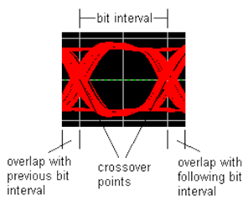
How to assess signal quality
Traditional SI measurements based on Vinh, Vinl switching thresholds.
Usually applied for a couple of pulses, originally just for the rising/falling edge. Used mostly to check slow switching signals with no jitter, no ISI, etc.
Min/Max delay
Static overshoot, Dynamic overshoot, Ringback, Monotonicity
Crosstalk
Constraints are defined per Net or Net Class in BoardSim.
Eye diagram / eye mask – for a long series of bits
Includes jitter and ISI effects

Slide 21
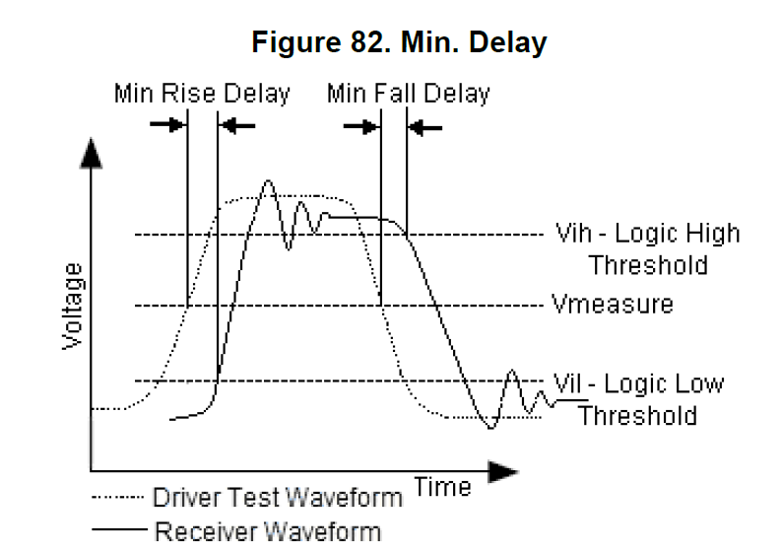
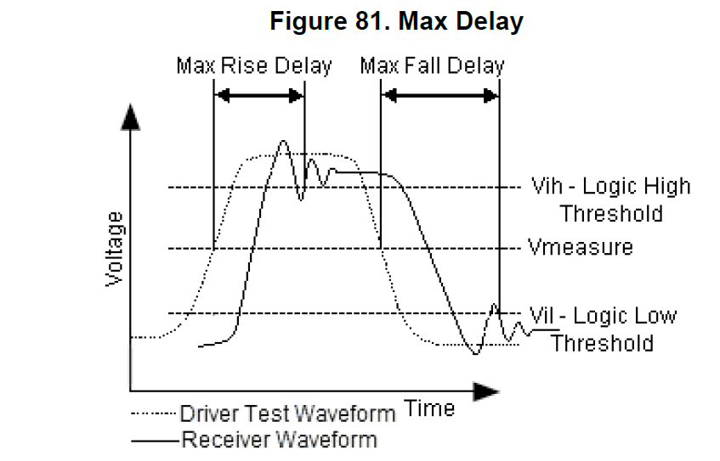
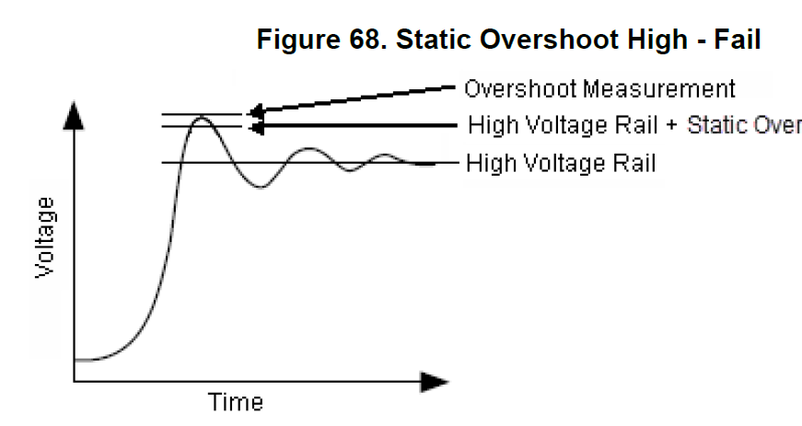
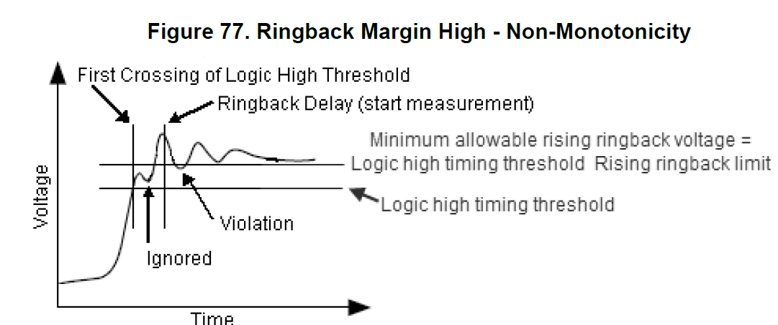
Traditional SI measurements

Slide 22
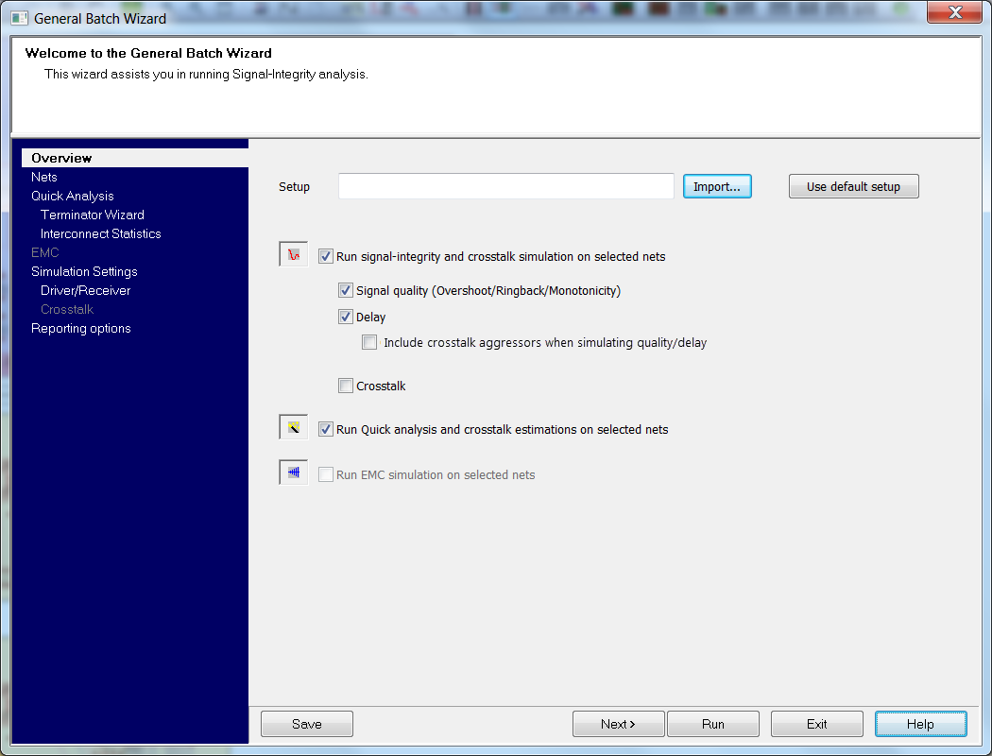
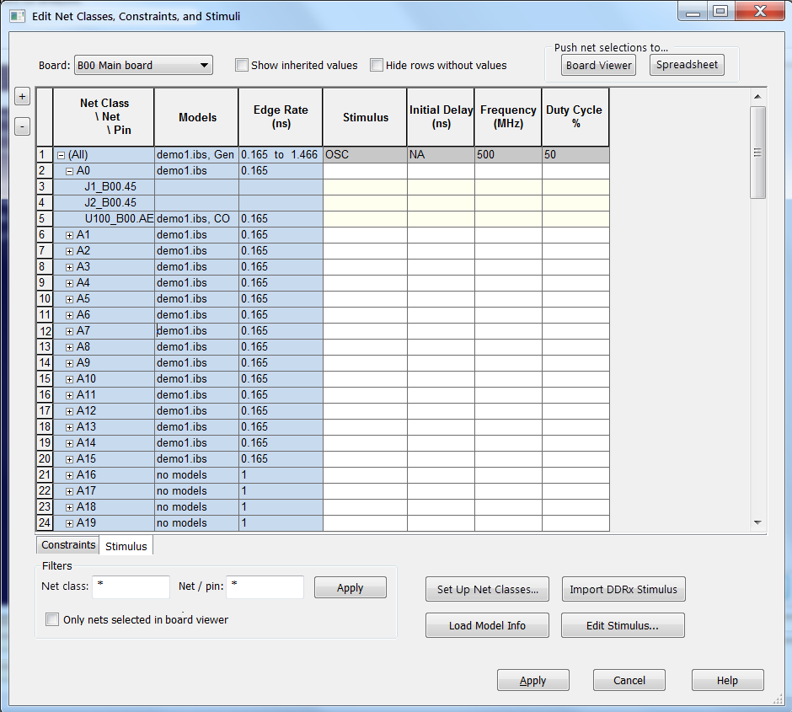
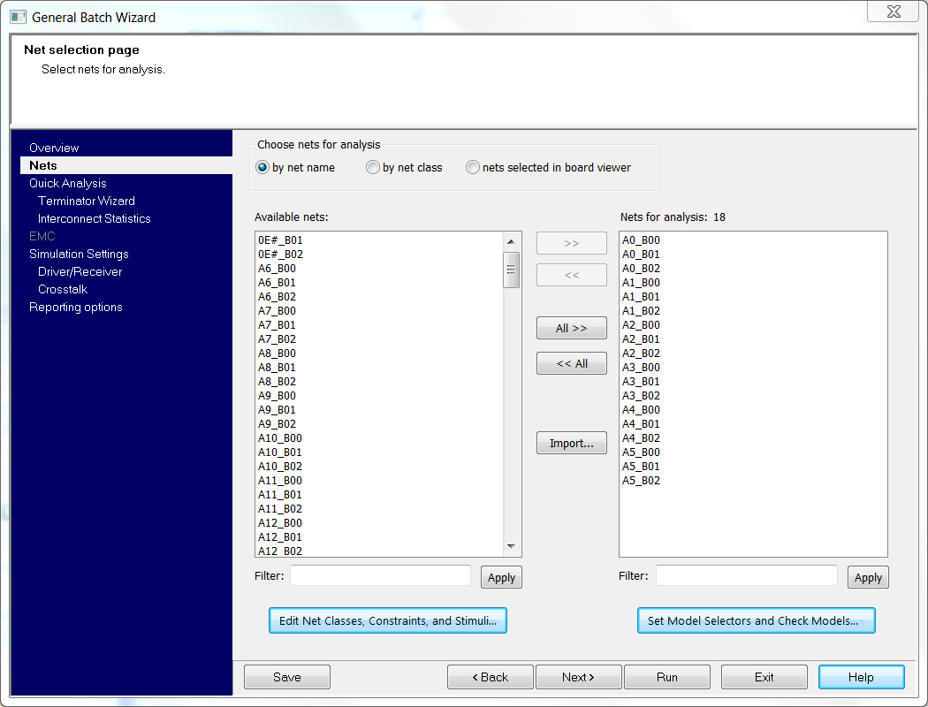
General Batch Wizard
Runs

Slide 23
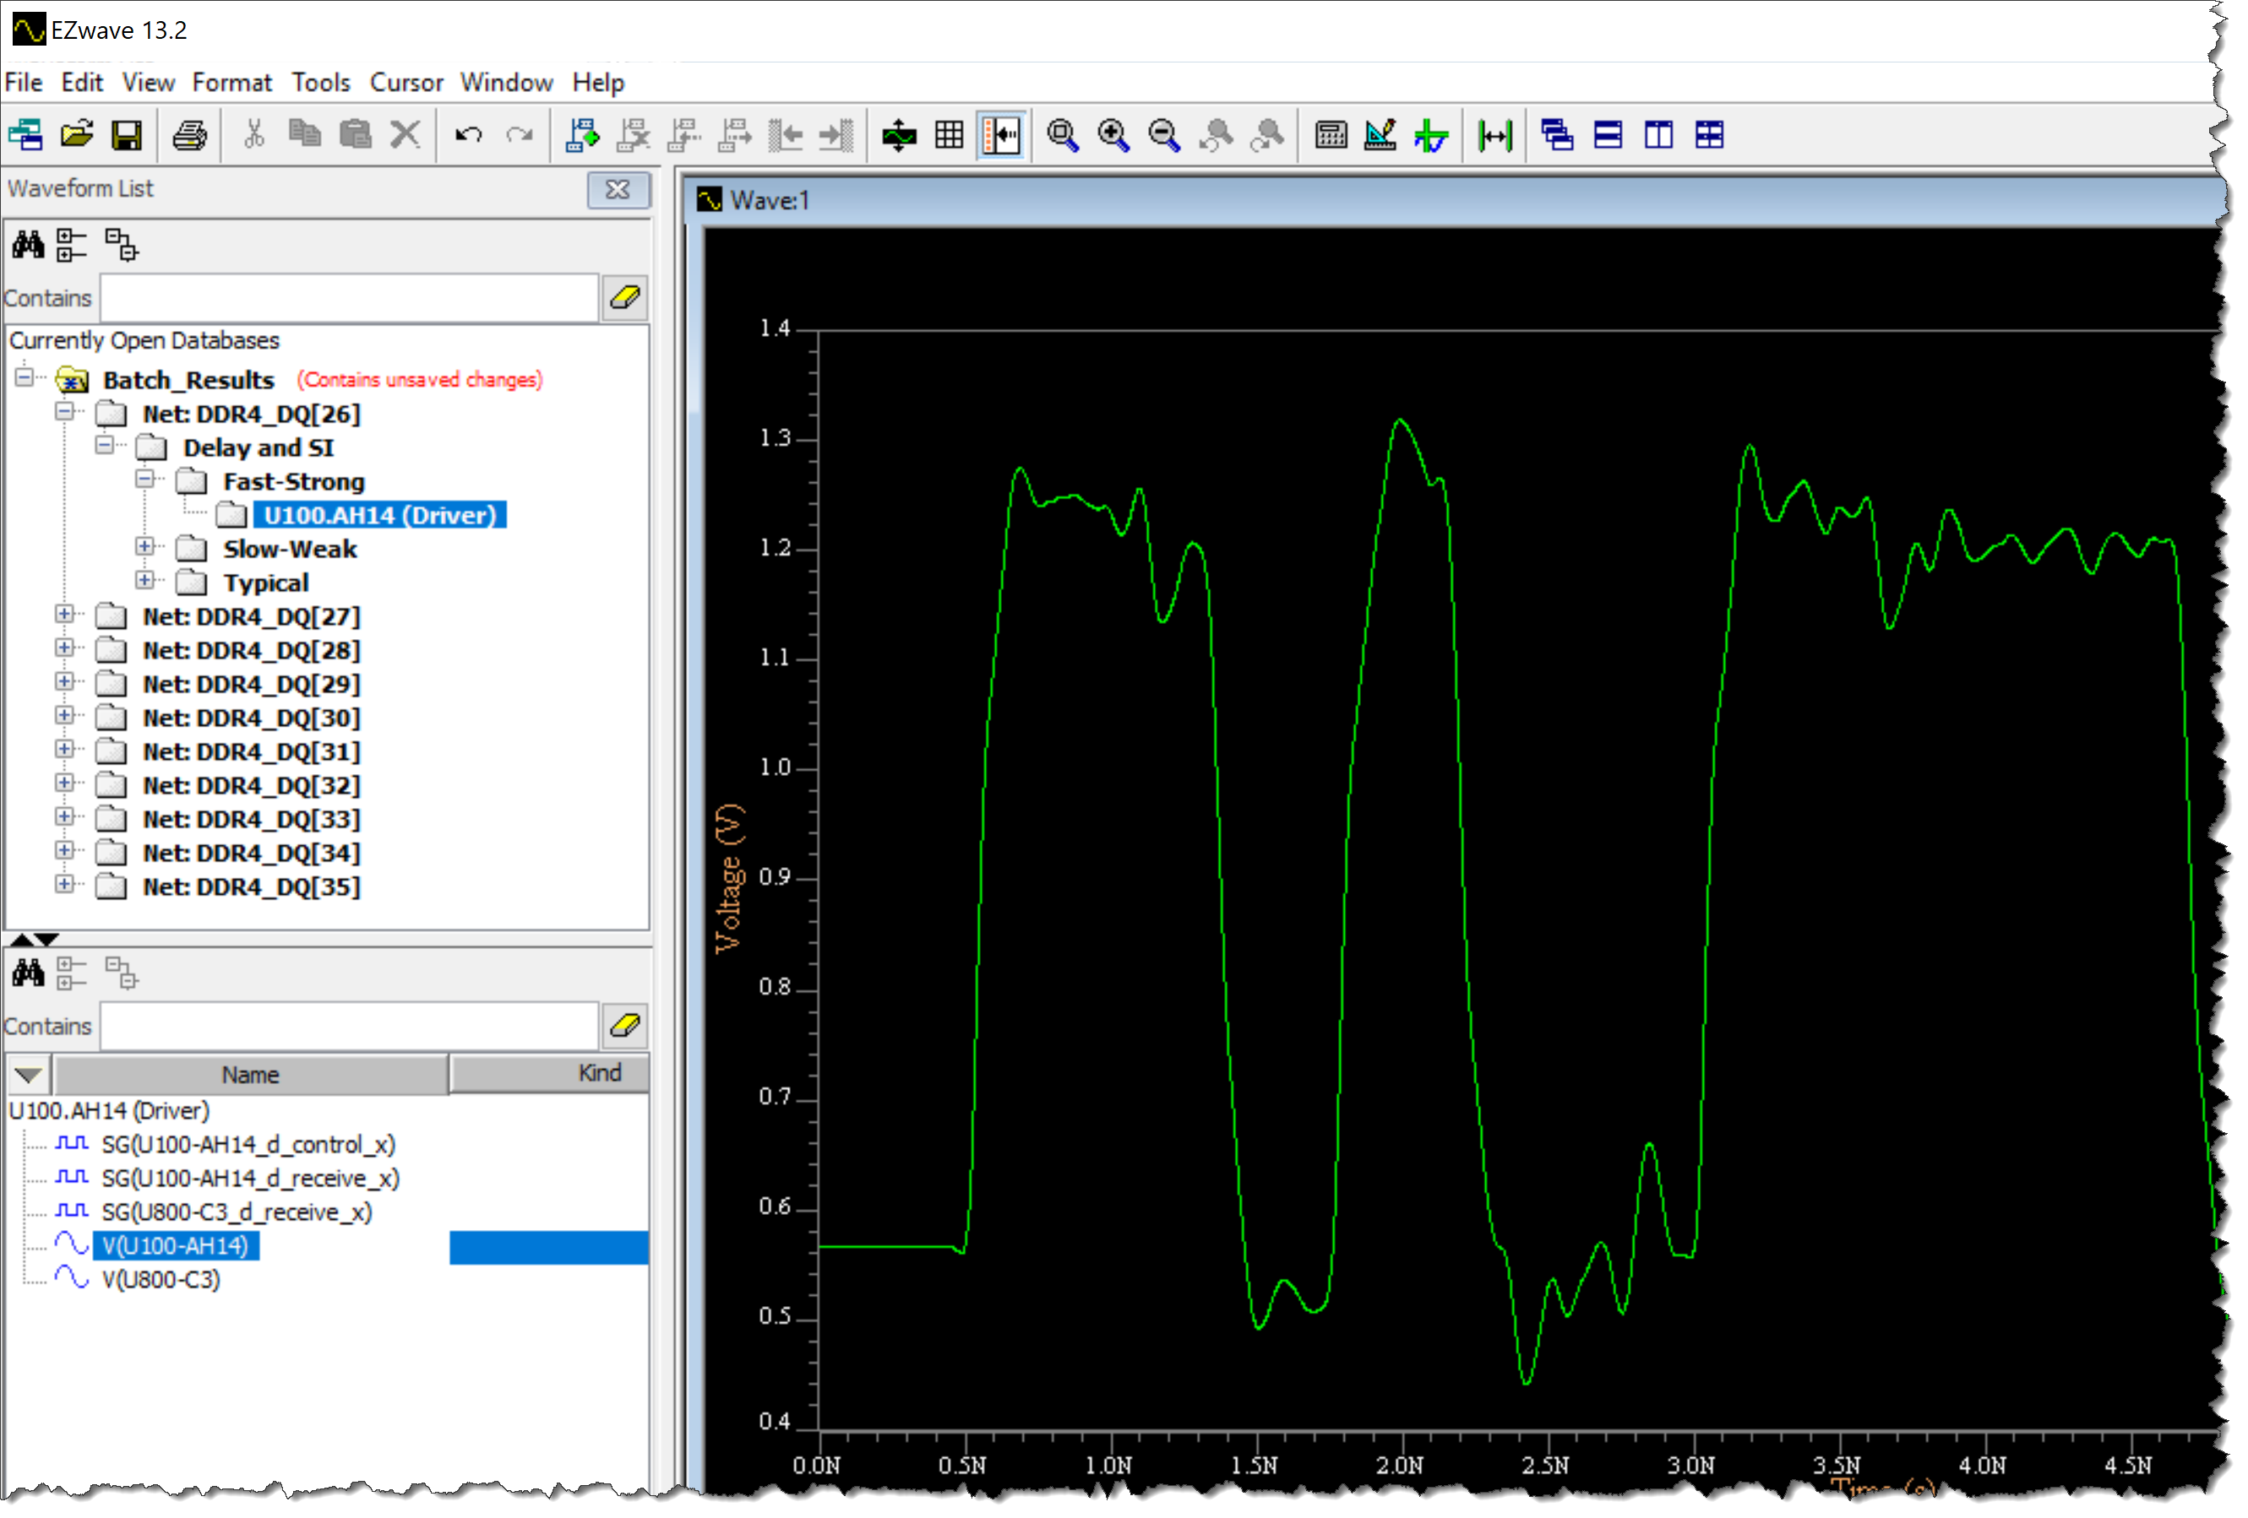
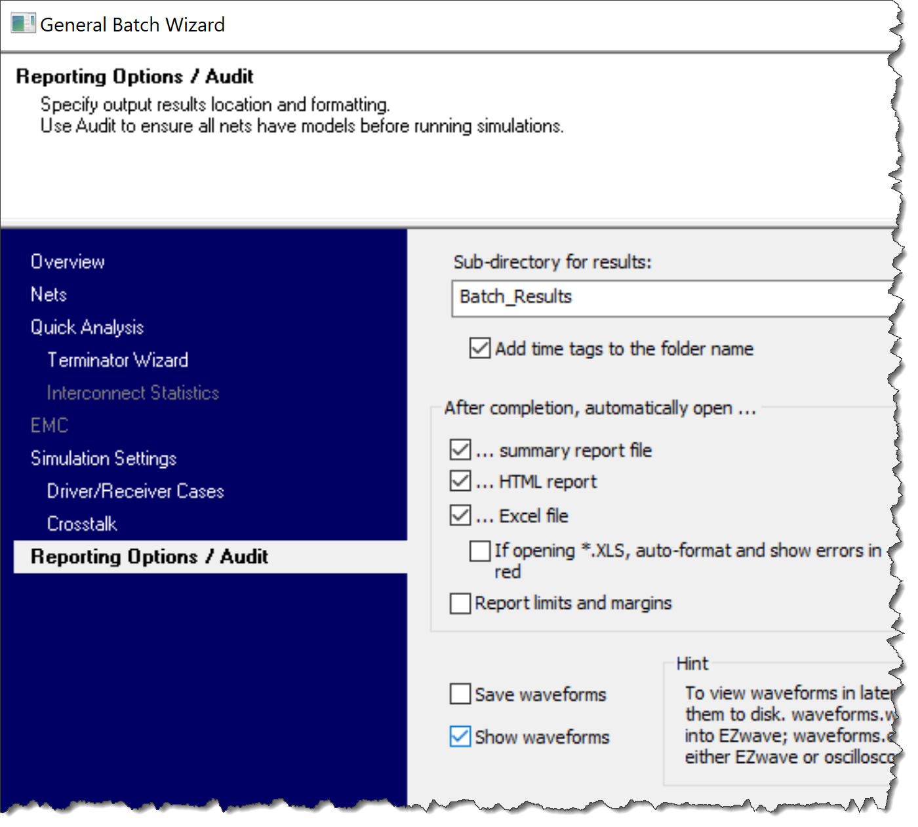
General Batch Wizard
Quick Analysis
SI Analysis (timing, SI, crosstalk)
EMC Analysis

Slide 24
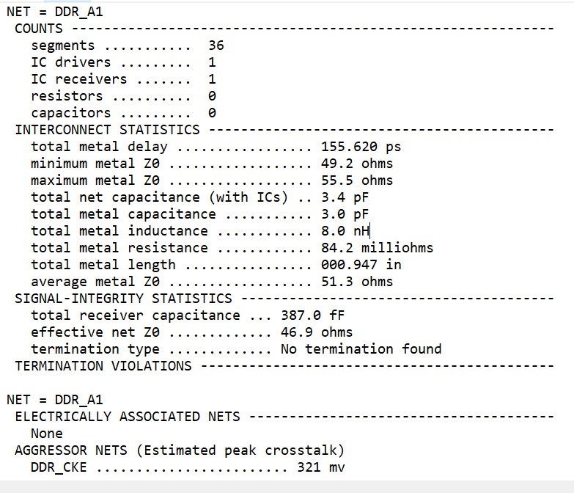
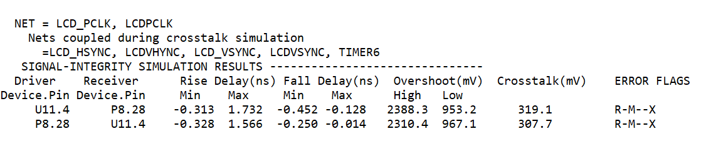
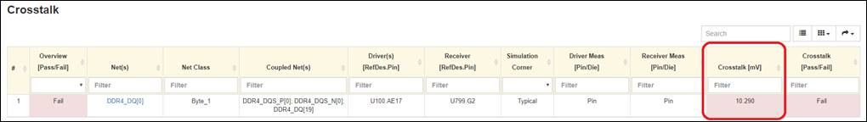
General Batch Wizard: results
Quick Analysis SI measurements

Slide 25
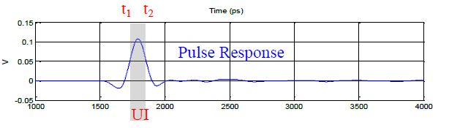
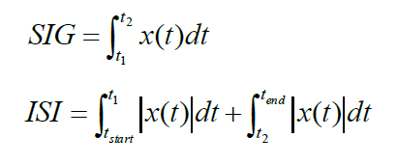
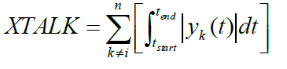
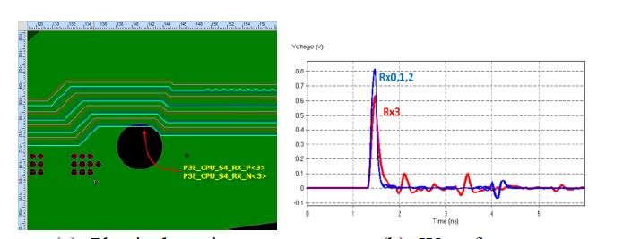
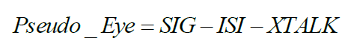
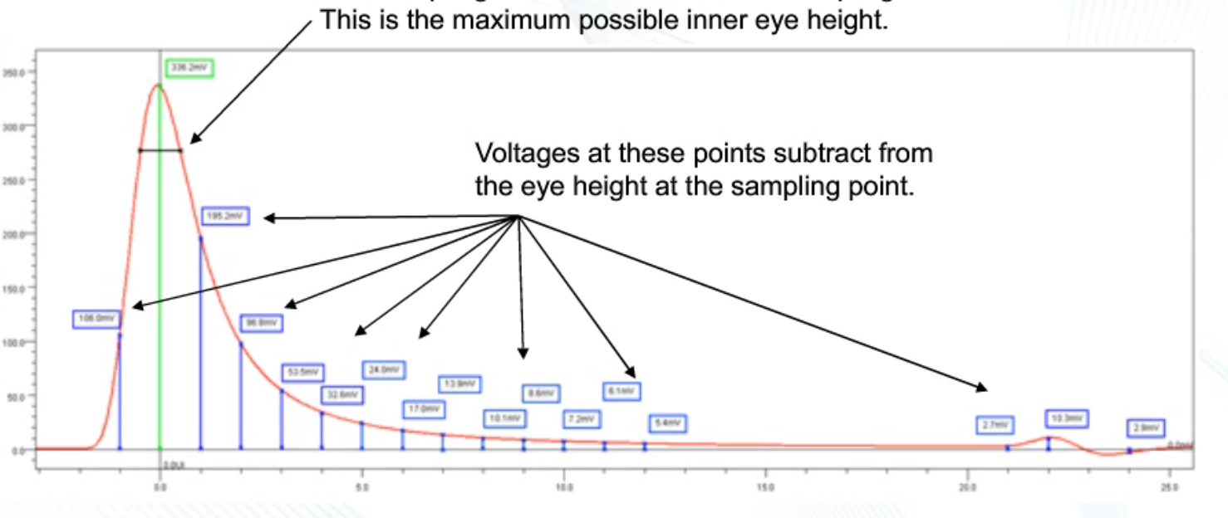
Pulse Response Wizard
Based on Intel’s Channel Checking Tool (CCT)

Slide 26
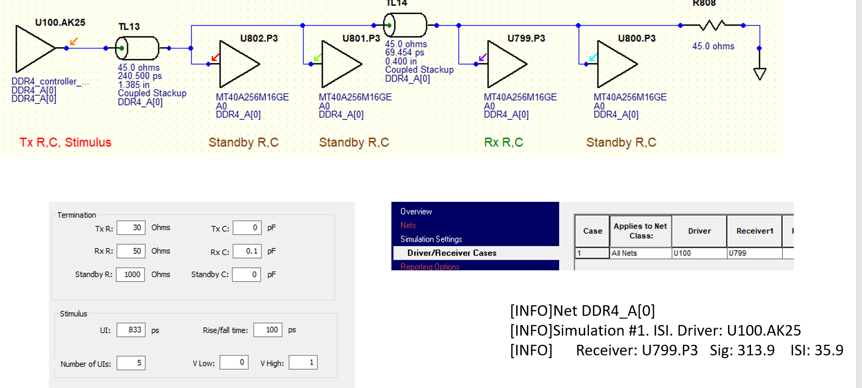
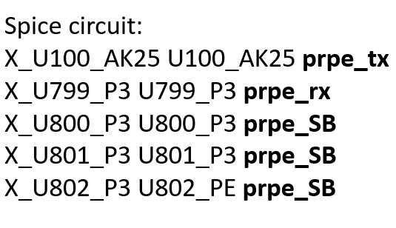
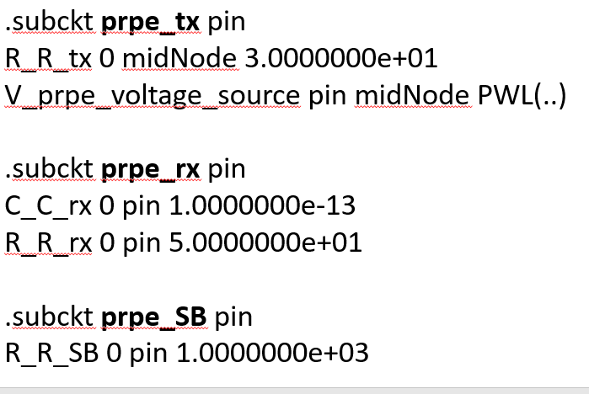
Pulse Response Wizard
GUI is very similar to General Batch Wizard.
You select nets, driver/receivers, termination (per net class) and hit Run.

Slide 27
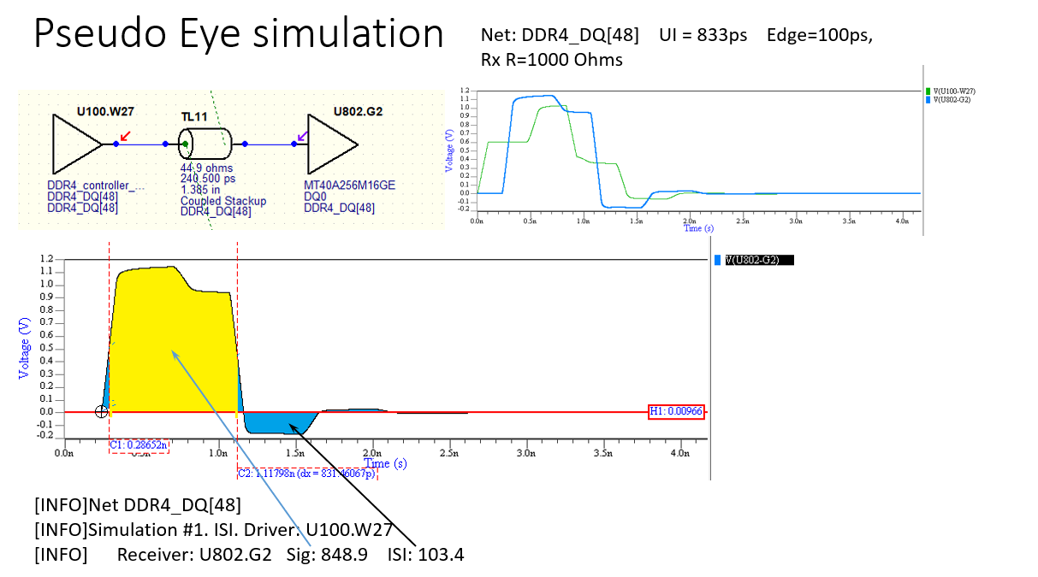
Summary

Slide 28
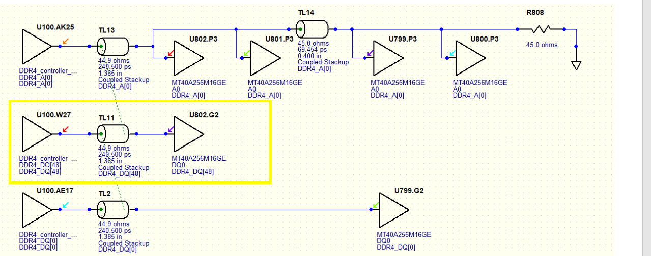
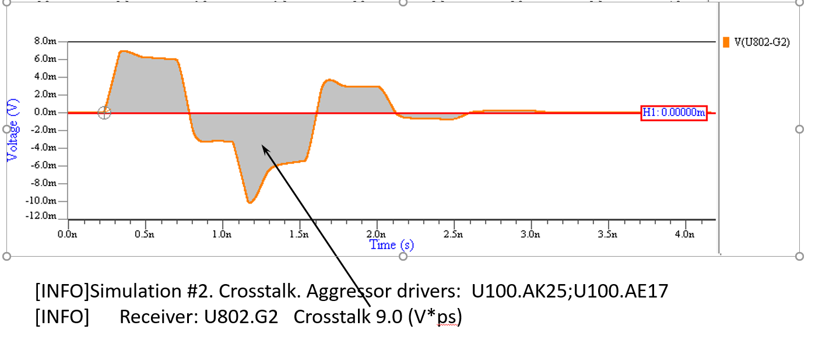
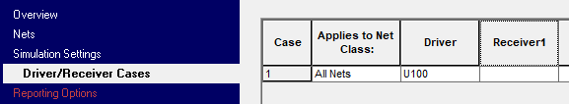
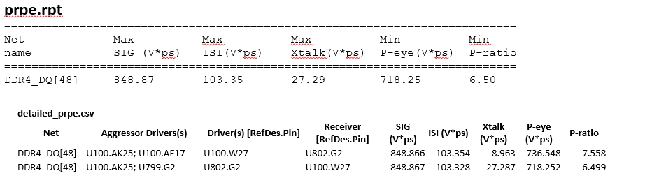
Pulse Response Wizard

Slide 29
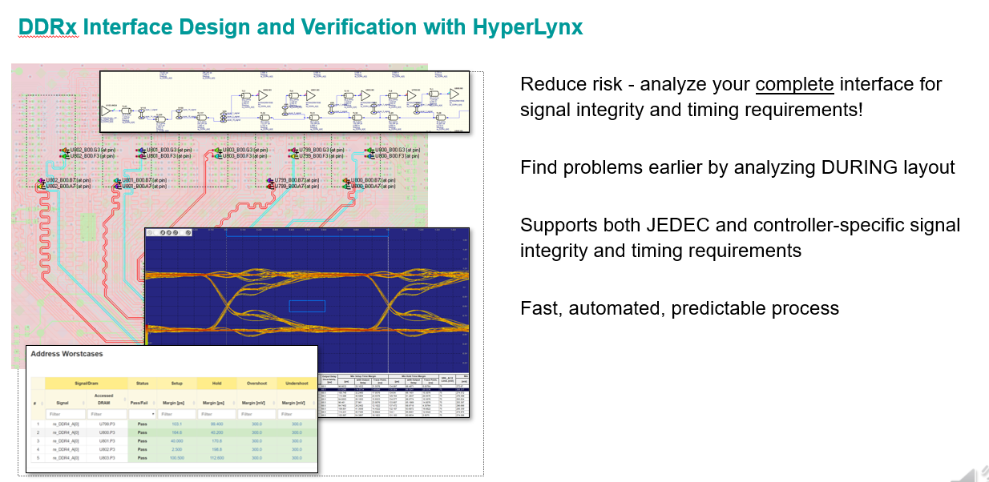
Summary

Slide 30

DDRx data rate

Slide 31

DDR routing topology

Slide 32

Summary

Slide 33

Summary
The end

Slide 34

Analyzing Serial Channels for Protocol Compliance
Dozens of specs, hundreds of pages (each)
Who has time to read them?
Differing analytical methods and Pass/Fail criteria:
Time-domain (eye masks)
Frequency-domain (frequency masks)
Channel Operating Margin (COM metric)
JEDEC Channel Operating Margin (JCOM metric)

Slide 35

DDR5 simulations
USE IBIS-AMI models with DFE equalization for single-ended DDR data lines
Flows:
Statistical AMI
Time Domain AMI
Advanced DDRx AMI.
Aka 4-steps flow, requires 2 long time domain simulations
More accurate, accounts for non-linear TX effects.
Really long simulations, usually more than 25K bits. Marketing expectation 1M bits.

Slide 36

Interactive DDR5 simulation

Slide 37
Summary

Slide 38

Via model in HyperLynx SI/PI
Via model in HL SI/PI is not power aware. But it attempts to estimate the effect of the return current transition between the planes.
If we inspect the via equivalent circuit in HL SI/PI we can find the large inductance between the plane layers. This one estimates the return current transition effect.
This inductance estimates the effect of the return current transition between the planes

Slide 39


Empty page

Slide 40

Summary

